Slide 1
Google Play Store Dashboard
Julia Zhao & Julien Mailloux

Slide 2
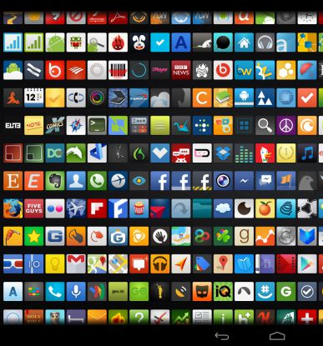
Outline
Data Acquisition
Data Understanding
Data Visualization
Summary
What’s next?

Slide 3

Data Acquisition
Google Play Store Apps Dataset
Kaggle 2018 dataset
Scraped using Jquery
2 csv files
15K entries in app file, 35K entries in review file

Slide 4
App Title
Category
Rating
# Reviews
Size
# Installs
Price
Content Rating
Google Play Store Apps
13 features including
Data Understanding
App Title
Translated Review
Sentiment Subjectivity
Sentiment
Sentiment Polarity
User Review Sentiment Analysis
4 features including

Slide 5


Data Visualization

Slide 6
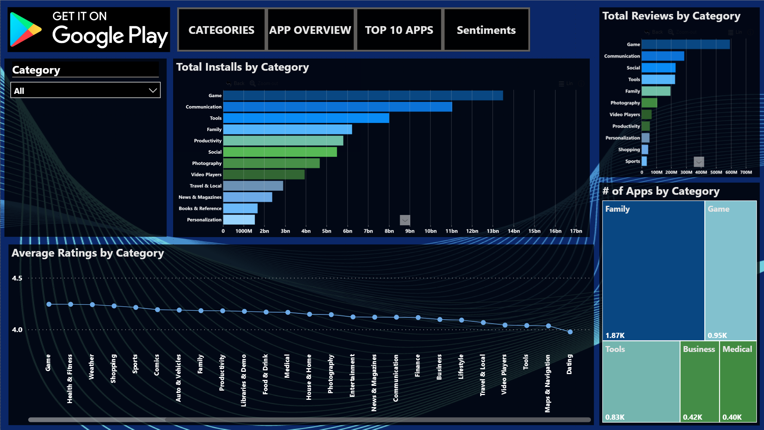

1st
2nd
4th
1st
5th
2nd
3rd
7th
4th
5th
Rating range [4.0 – 4.5]
9th
16th
17th
25th
31st
Notes:
1st Interesting : A relatively narrow rating range from 4.0 to 4.5
2nd The top 5 categories for total installs are also among the most reviewed

Slide 7
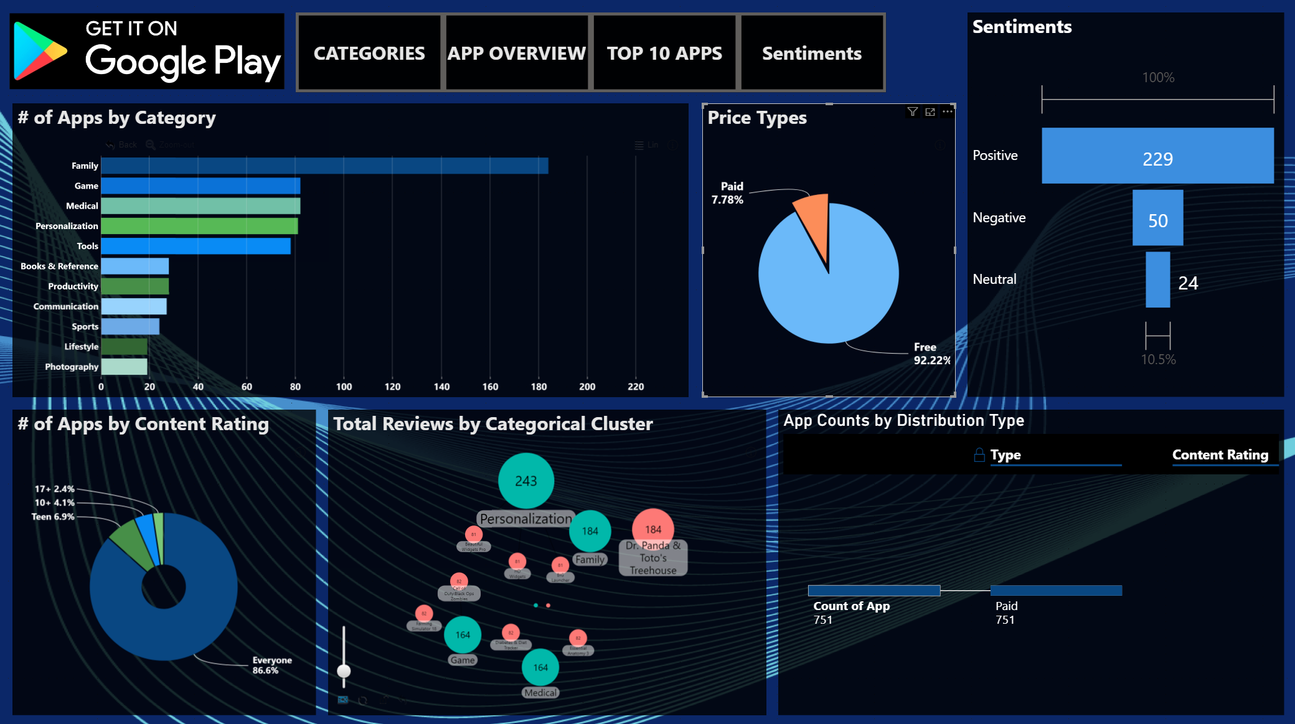
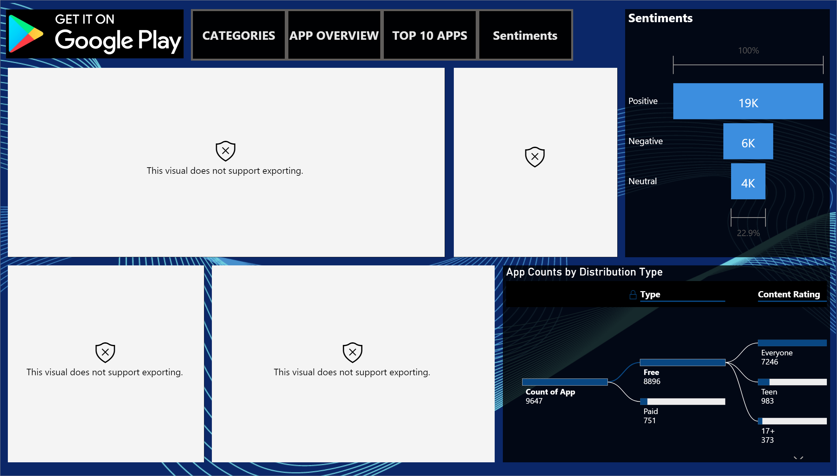
76%
17%
8%

Slide 8
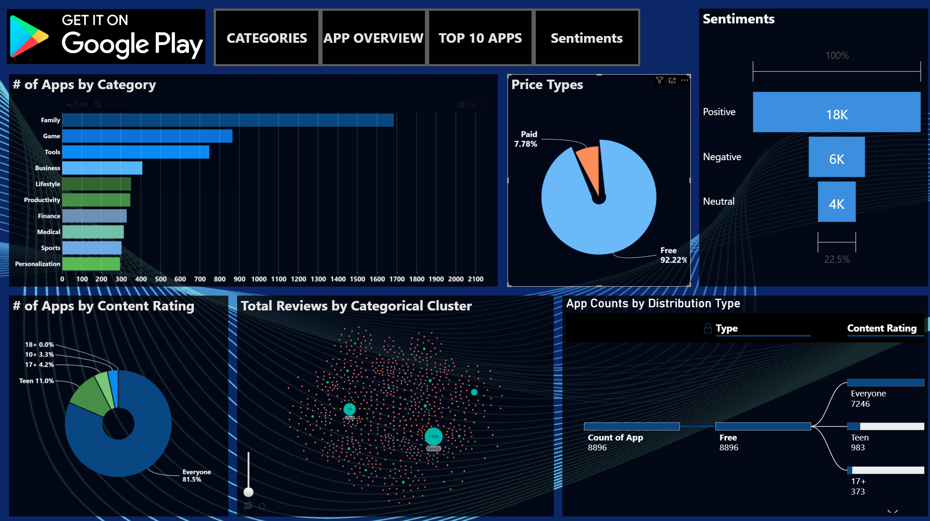
64%
21%
14%

Slide 9
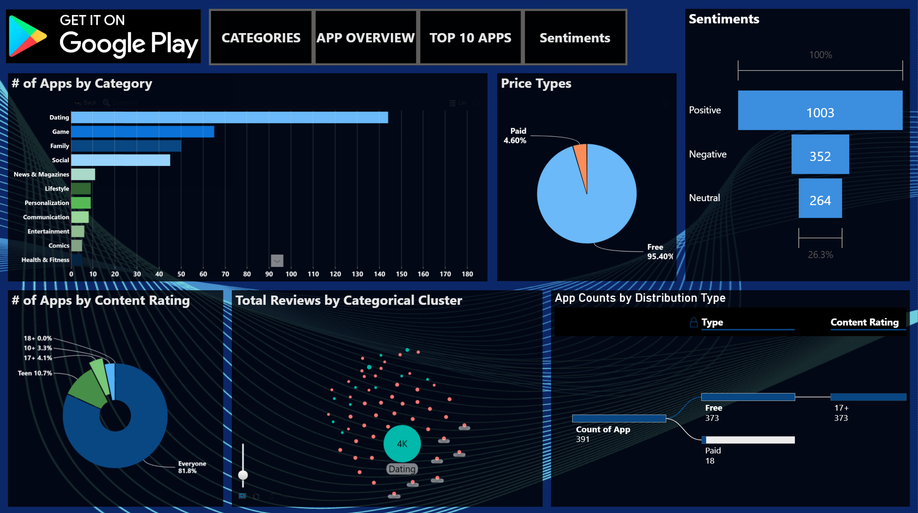
62%
22%
16%

Slide 10
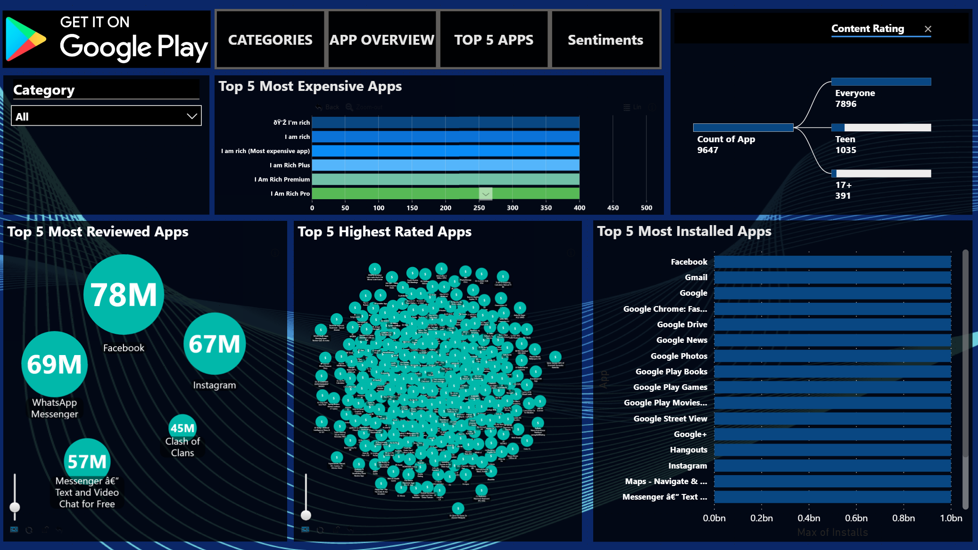
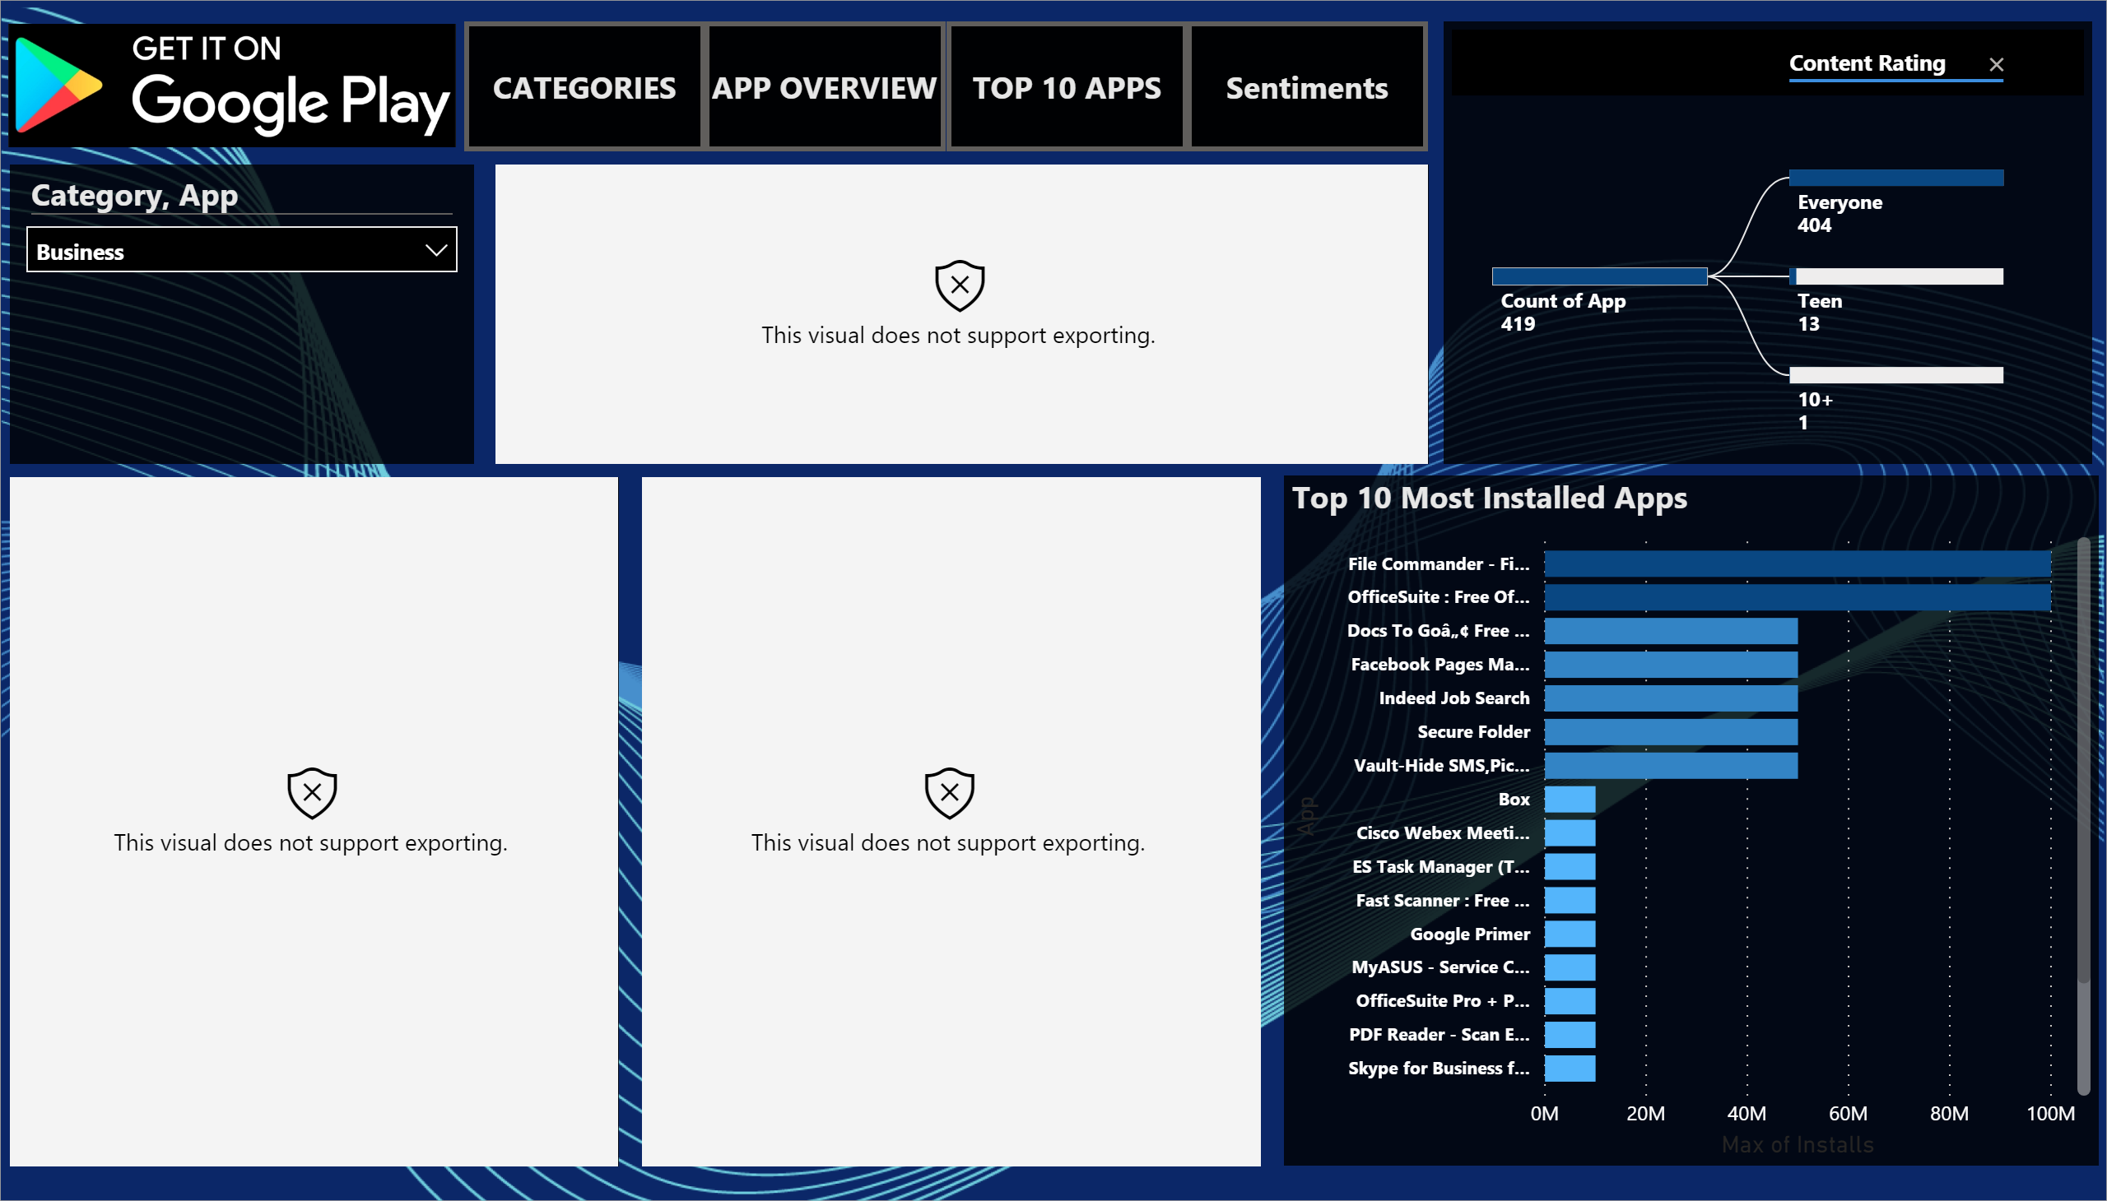
Finance Apps
Google Hegemony
Social Media
Game

Slide 11
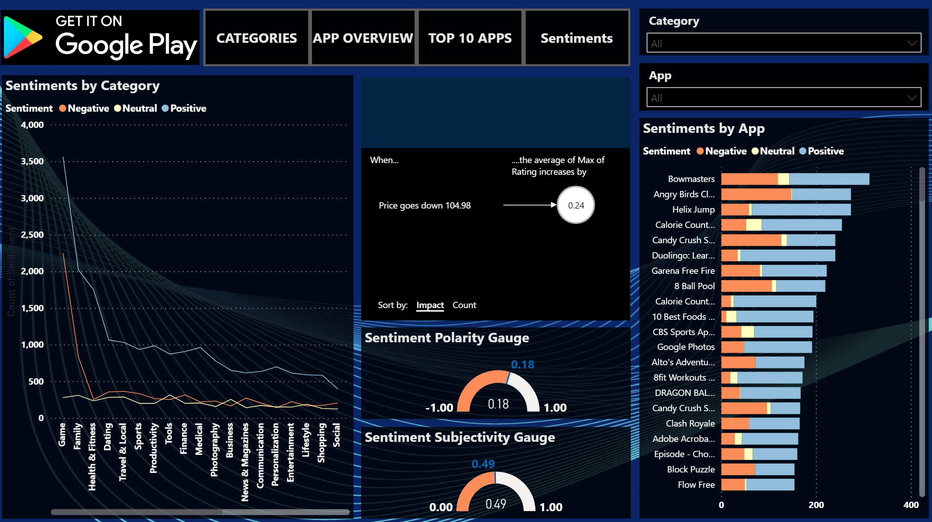
Categories Unleashing Passion

Slide 12
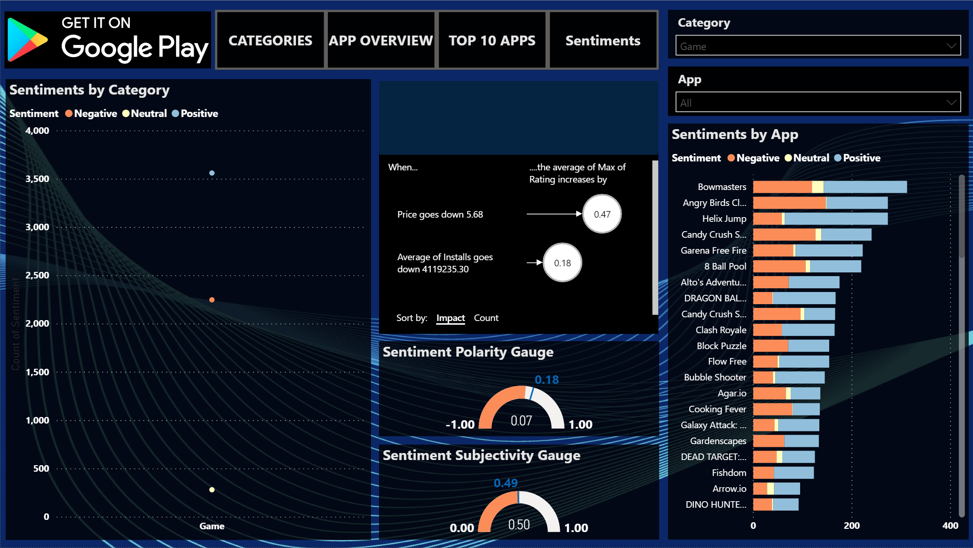
Impacting Rating

Slide 13
Summary
Categories
Rating range [4.0 – 4.5]
↑ Installed categories ↓ rated apps
App Overview
Paid apps = 76% Positive Sentiment
Free apps = 64% Positive Sentiment
17 + Rating ≅ Dating apps

Slide 14
Summary
(Continued)
Top 5 apps
Top 5 expensive = finance apps
Top 5 installed = Google apps
Top 5 reviewed = Social Media apps
Sentiments
Most reviewed= Game & Family
Price ↓ $5.68
Rating ↑ 0.47
Installs↑ 4,119,235
Rating ↓ 0.18

Slide 15

What’s Next?
Build a larger and updated dataset
Use Tableau
Generate relative variables

Slide 16

Questions?

